Slide 1
ECON1002 Intro. Macro.
Tutorial 10
Herbert Xin
wei.xin@sydney.edu.au

Slide 2
Plan of Today
Concept Review
Tutorial Questions
Preparation for Essay Task
More details out now!
Open: Apr 29th
Due: May 11th
Replacement test: Week 11th

Slide 3
Concept Review

Slide 4
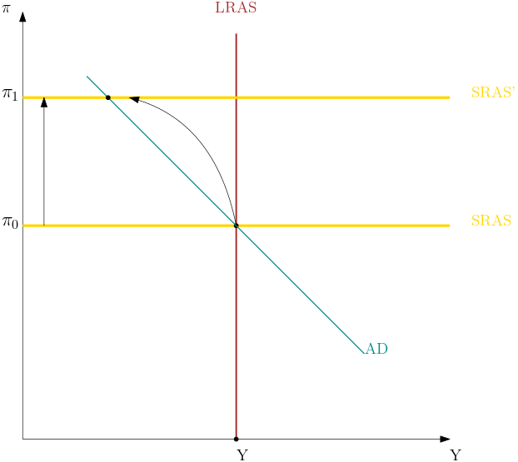
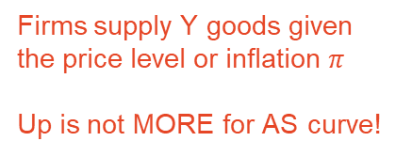
Oil Price and AS Curve
Suppose that a permanent increase in oil prices creates an inflationary shock and reduces potential output.
Firms supply Y goods given the price level or inflation $π$
Up is not MORE for AS curve!

Slide 5
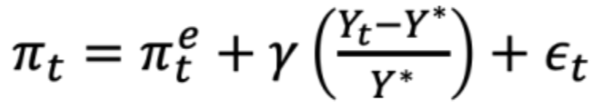
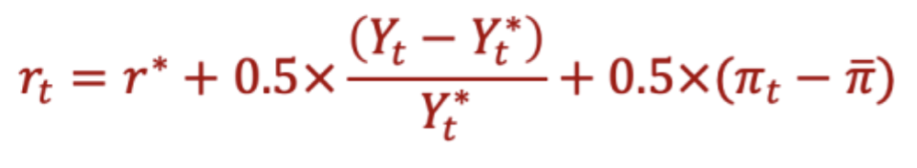
Self-Correcting Mechanism
The economy will self-correct due to the Philips curve.
And central banks’ policy response

Slide 6
Tutorial Questions

Slide 7
Question 1
You have employed 5 workers of varying physical strength to dig a ditch. Workers without shovels have zero productivity in ditch digging. How should you assign shovels to workers if you do not have enough shovels going around? How should you assign any additional shovels that you obtain? Using this example, discuss (a) the relationship between the availability of physical capital and average labour productivity and (b) the concept of diminishing returns to capital

Slide 8
Question 1
You have employed 5 workers of varying physical strength to dig a ditch. Workers without shovels have zero productivity in ditch digging. How should you assign shovels to workers if you do not have enough shovels going around? How should you assign any additional shovels that you obtain? Using this example, discuss (a) the relationship between the availability of physical capital and average labour productivity and (b) the concept of diminishing returns to capital

Slide 9
Question 1
You have employed 5 workers of varying physical strength to dig a ditch. Workers without shovels have zero productivity in ditch digging. How should you assign shovels to workers if you do not have enough shovels going around? How should you assign any additional shovels that you obtain? Using this example, discuss (a) the relationship between the availability of physical capital and average labour productivity and (b) the concept of diminishing returns to capital

Slide 10
Question 1
You have employed 5 workers of varying physical strength to dig a ditch. Workers without shovels have zero productivity in ditch digging. How should you assign shovels to workers if you do not have enough shovels going around? How should you assign any additional shovels that you obtain? Using this example, discuss (a) the relationship between the availability of physical capital and average labour productivity and (b) the concept of diminishing returns to capital
Say we have 3 shovels, how would you assign it?

Slide 11
Question 1
You have employed 5 workers of varying physical strength to dig a ditch. Workers without shovels have zero productivity in ditch digging. How should you assign shovels to workers if you do not have enough shovels going around? How should you assign any additional shovels that you obtain? Using this example, discuss (a) the relationship between the availability of physical capital and average labour productivity and (b) the concept of diminishing returns to capital
Say we have 3 shovels, how would you assign it?
Now if we have 4, what would you do

Slide 12
Question 1
You have employed 5 workers of varying physical strength to dig a ditch. Workers without shovels have zero productivity in ditch digging. How should you assign shovels to workers if you do not have enough shovels going around? How should you assign any additional shovels that you obtain? Using this example, discuss (a) the relationship between the availability of physical capital and average labour productivity and (b) the concept of diminishing returns to capital.
Low hanging fruit principle
Extra capital enhances average labour productivity
Extra output from additional shovel is decreasing

Slide 13
Question 3
Why does the government subsidise most students at public tertiary institutions rather
than having students pay the full cost of their education? (In particular, think about the
implications for economic growth)

Slide 14
Question 3
Why does the government subsidise most students at public tertiary institutions rather
than having students pay the full cost of their education? (In particular, think about the
implications for economic growth)
Human Capital
Total Factor Productivity

Slide 15
Question 4
Assume that the aggregate production function for an economy is described by: $Y=AK^{α}L^{1−α}$, where $0<α<1$.

Slide 16
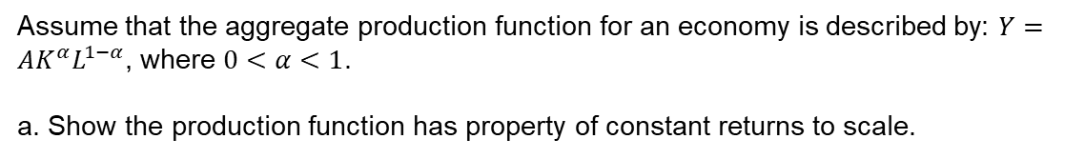
Question 4
Assume that the aggregate production function for an economy is described by: $Y=AK^{α}L^{1−α}$, where $0<α<1$.
a. Show the production function has property of constant returns to scale.

Slide 17
Question 4
Assume that the aggregate production function for an economy is described by: $Y=AK^{α}L^{1−α}$, where $0<α<1$.
a. Show the production function has property of constant returns to scale.
We have $Y=AK^{α}L^{1−α}$, if we increase $K$ and $L$ by 2

Slide 18

Question 4
Assume that the aggregate production function for an economy is described by: $Y=AK^{α}L^{1−α}$, where $0<α<1$.
a. Show the production function has property of constant returns to scale.
We have $Y=AK^{α}L^{1−α}$, if we increase $K$ and $L$ by 2
Gives $A{\left(2K\right)}^{α}{\left(2L\right)}^{1−α}$

Slide 19
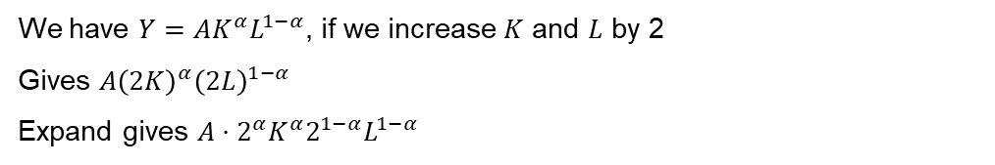
Question 4
Assume that the aggregate production function for an economy is described by: $Y=AK^{α}L^{1−α}$, where $0<α<1$.
a. Show the production function has property of constant returns to scale.
We have $Y=AK^{α}L^{1−α}$, if we increase $K$ and $L$ by 2
Gives $A{\left(2K\right)}^{α}{\left(2L\right)}^{1−α}$
Expand gives $A⋅2^{α}K^{α}2^{1−α}L^{1−α}$

Slide 20
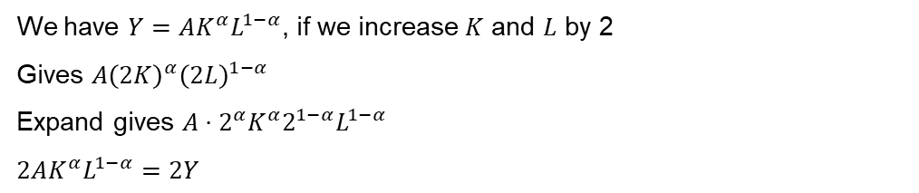
Question 4
Assume that the aggregate production function for an economy is described by: $Y=AK^{α}L^{1−α}$, where $0<α<1$.
a. Show the production function has property of constant returns to scale.
We have $Y=AK^{α}L^{1−α}$, if we increase $K$ and $L$ by 2
Gives $A{\left(2K\right)}^{α}{\left(2L\right)}^{1−α}$
Expand gives $A⋅2^{α}K^{α}2^{1−α}L^{1−α}$
$$2AK^{α}L^{1−α}=2Y$$

Slide 21
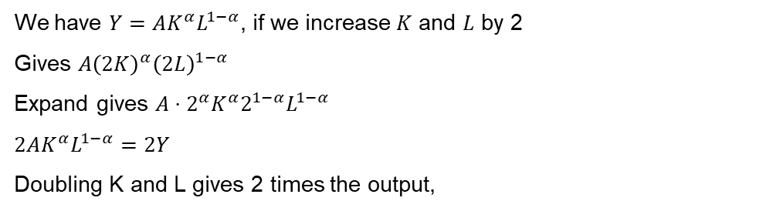
Question 4
Assume that the aggregate production function for an economy is described by: $Y=AK^{α}L^{1−α}$, where $0<α<1$.
a. Show the production function has property of constant returns to scale.
We have $Y=AK^{α}L^{1−α}$, if we increase $K$ and $L$ by 2
Gives $A{\left(2K\right)}^{α}{\left(2L\right)}^{1−α}$
Expand gives $A⋅2^{α}K^{α}2^{1−α}L^{1−α}$
$$2AK^{α}L^{1−α}=2Y$$
Doubling K and L gives 2 times the output,

Slide 22
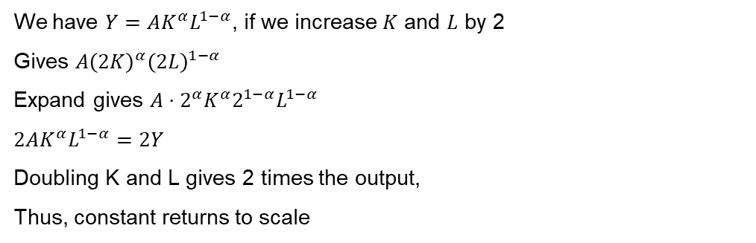
Question 4
Assume that the aggregate production function for an economy is described by: $Y=AK^{α}L^{1−α}$, where $0<α<1$.
a. Show the production function has property of constant returns to scale.
We have $Y=AK^{α}L^{1−α}$, if we increase $K$ and $L$ by 2
Gives $A{\left(2K\right)}^{α}{\left(2L\right)}^{1−α}$
Expand gives $A⋅2^{α}K^{α}2^{1−α}L^{1−α}$
$$2AK^{α}L^{1−α}=2Y$$
Doubling K and L gives 2 times the output,
Thus, constant returns to scale

Slide 23
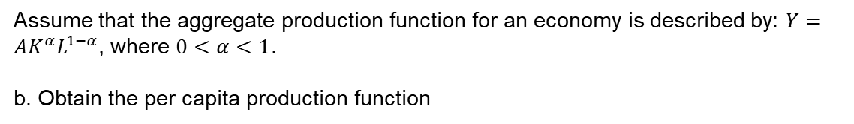
Question 4
Assume that the aggregate production function for an economy is described by: $Y=AK^{α}L^{1−α}$, where $0<α<1$.
b. Obtain the per capita production function
We have $Y=AK^{α}L^{1−α}$, divide the production function by $L$, which gives

Slide 24
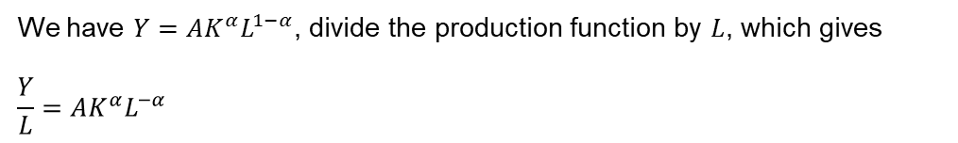
Question 4
Assume that the aggregate production function for an economy is described by: $Y=AK^{α}L^{1−α}$, where $0<α<1$.
b. Obtain the per capita production function
We have $Y=AK^{α}L^{1−α}$, divide the production function by $L$, which gives
$$\frac{Y}{L}=AK^{α}L^{−α}$$

Slide 25
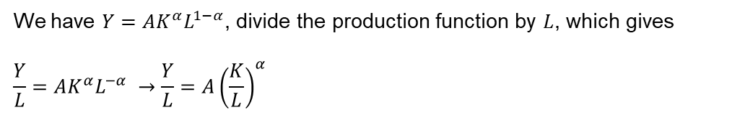
Question 4
Assume that the aggregate production function for an economy is described by: $Y=AK^{α}L^{1−α}$, where $0<α<1$.
b. Obtain the per capita production function
We have $Y=AK^{α}L^{1−α}$, divide the production function by $L$, which gives
$$\frac{Y}{L}=AK^{α}L^{−α} →\frac{Y}{L}=A{\left(\frac{K}{L}\right)}^{α}$$

Slide 26
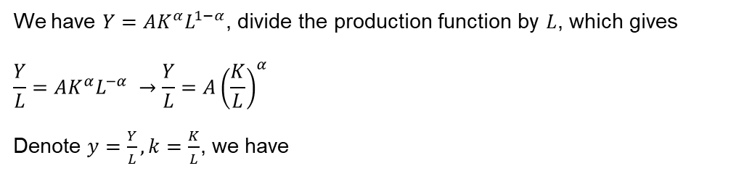
Question 4
Assume that the aggregate production function for an economy is described by: $Y=AK^{α}L^{1−α}$, where $0<α<1$.
b. Obtain the per capita production function
We have $Y=AK^{α}L^{1−α}$, divide the production function by $L$, which gives
$$\frac{Y}{L}=AK^{α}L^{−α} →\frac{Y}{L}=A{\left(\frac{K}{L}\right)}^{α}$$
Denote $y=\frac{Y}{L}, k=\frac{K}{L}$, we have

Slide 27
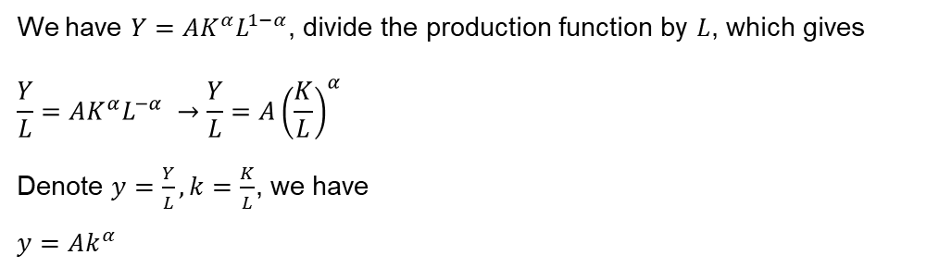
Question 4
Assume that the aggregate production function for an economy is described by: $Y=AK^{α}L^{1−α}$, where $0<α<1$.
b. Obtain the per capita production function
We have $Y=AK^{α}L^{1−α}$, divide the production function by $L$, which gives
$$\frac{Y}{L}=AK^{α}L^{−α} →\frac{Y}{L}=A{\left(\frac{K}{L}\right)}^{α}$$
Denote $y=\frac{Y}{L}, k=\frac{K}{L}$, we have
$$y=Ak^{α}$$

Slide 28
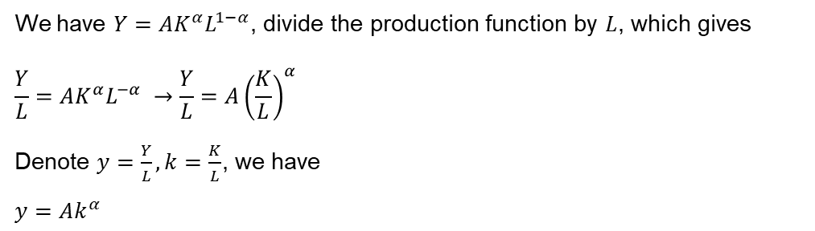
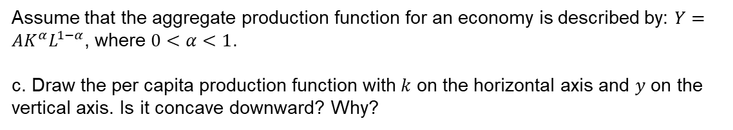
Question 4
Assume that the aggregate production function for an economy is described by: $Y=AK^{α}L^{1−α}$, where $0<α<1$.
c. Draw the per capita production function with 𝑘 on the horizontal axis and 𝑦 on the vertical axis. Is it concave downward? Why?
We have $Y=AK^{α}L^{1−α}$, divide the production function by $L$, which gives
$$\frac{Y}{L}=AK^{α}L^{−α} →\frac{Y}{L}=A{\left(\frac{K}{L}\right)}^{α}$$
Denote $y=\frac{Y}{L}, k=\frac{K}{L}$, we have
$$y=Ak^{α}$$

Slide 29
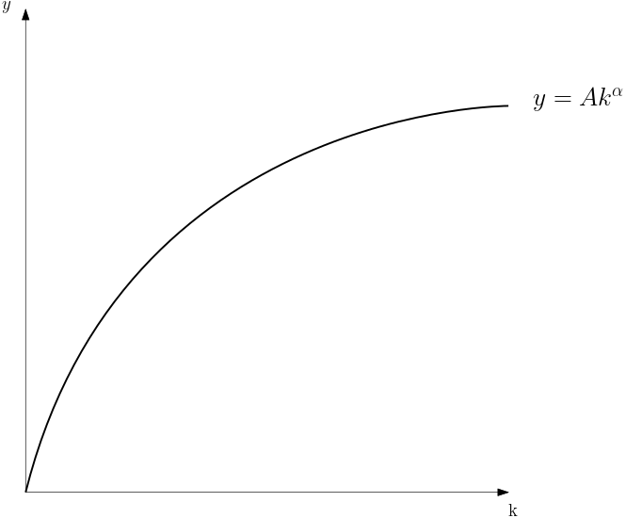
Question 4
Assume that the aggregate production function for an economy is described by: $Y=AK^{α}L^{1−α}$, where $0<α<1$.
c. Draw the per capita production function with 𝑘 on the horizontal axis and 𝑦 on the vertical axis. Is it concave downward? Why?

Slide 30
Question 4
Assume that the aggregate production function for an economy is described by: $Y=AK^{α}L^{1−α}$, where $0<α<1$.
c. Draw the per capita production function with 𝑘 on the horizontal axis and 𝑦 on the vertical axis. Is it concave downward? Why?
Concave downward
Diminishing marginal return

Slide 31
Question 5
Which of the following would be the most helpful in raising Australia’s standard of living in the long run? Discuss.
A policy of making firing workers more difficult, other things held constant.
A government policy of giving more assistance to first home buyers and hence raising the overall level of consumption.
A government policy of increasing funding on universities and TAFE (technical and further educations) colleges.
A policy of increasing money supply along with fiscal expansion, other things held constant.

Slide 32
Question 5
Which of the following would be the most helpful in raising Australia’s standard of living in the long run? Discuss.
A policy of making firing workers more difficult, other things held constant.
A government policy of giving more assistance to first home buyers and hence raising the overall level of consumption.
A government policy of increasing funding on universities and TAFE (technical and further educations) colleges.
A policy of increasing money supply along with fiscal expansion, other things held constant.

Slide 33
Question 5
Which of the following would be the most helpful in raising Australia’s standard of living in the long run? Discuss.
A policy of making firing workers more difficult, other things held constant.
A government policy of giving more assistance to first home buyers and hence raising the overall level of consumption.
A government policy of increasing funding on universities and TAFE (technical and further educations) colleges.
A policy of increasing money supply along with fiscal expansion, other things held constant.
More labor market rigidity, likely to reduce labor participation
Increases Aggregate Demand (AD)
Raises human capital and TFP
Increases Aggregate Demand (AD)

Slide 34
Preparation for Essay Task

Slide 35
Question 6
“Explain the monetary and fiscal policies implemented in Australia after Covid-19 lockdowns were over”
Engage in a conversation with Bing Copilot so it gives the most accurate response
Think how the response you got could be further improved
Think of extra explanation and analysis using relevant theories, graphs, equations, or other evidence.

Slide 36
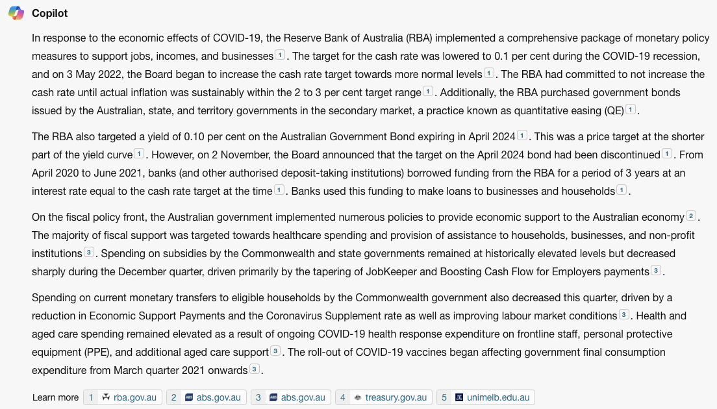

Slide 37
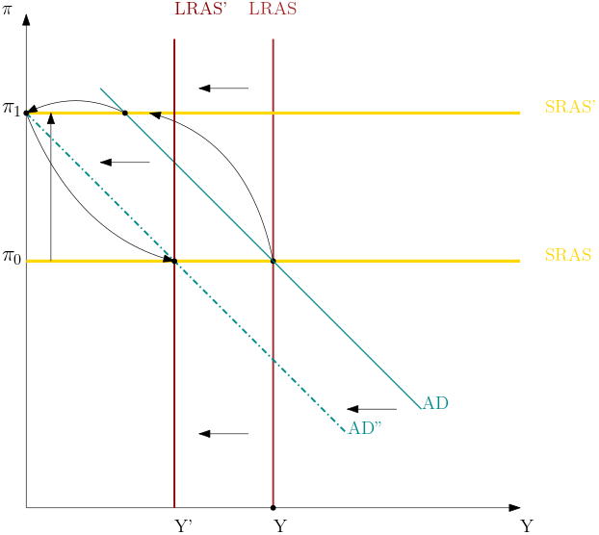

Slide 38
After COVID-19
AD shifts right

Slide 39
After COVID-19
AD shifts right
SRAS shifts up

Slide 40

After COVID-19
AD shifts right
SRAS shifts up
RBA raises $i$

Slide 41
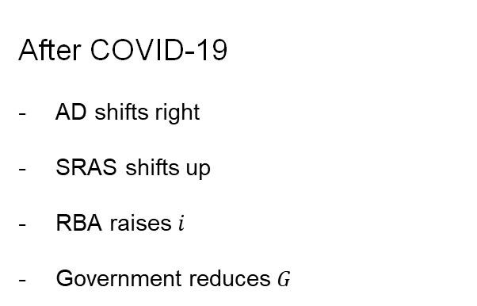
After COVID-19
AD shifts right
SRAS shifts up
RBA raises $i$
Government reduces $G$

Slide 42
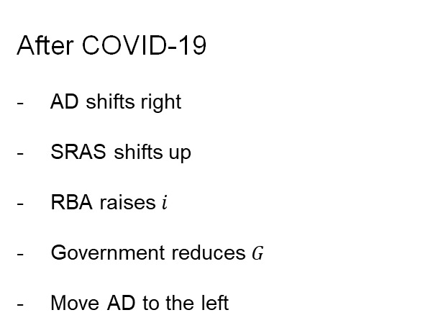
After COVID-19
AD shifts right
SRAS shifts up
RBA raises $i$
Government reduces $G$
Move AD to the left

Slide 43
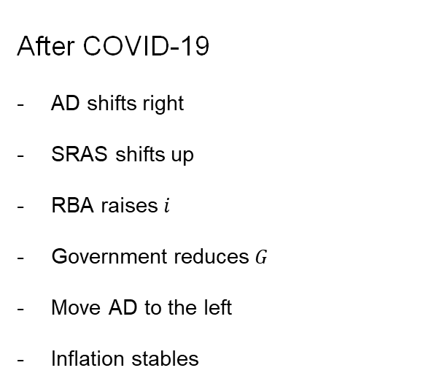
After COVID-19
AD shifts right
SRAS shifts up
RBA raises $i$
Government reduces $G$
Move AD to the left
Inflation stables

Slide 44
Questions?

